Slide 1

Making if statement using tensorflow - tf.cond

Slide 2
Reference
Youtube
Code

Slide 3
Task

Slide 4

If True Compute 2+3 If False Compute 2*3

Slide 5
If True Compute 2+3 If False Compute 2*3

Slide 6
if x: - Fail

Slide 7
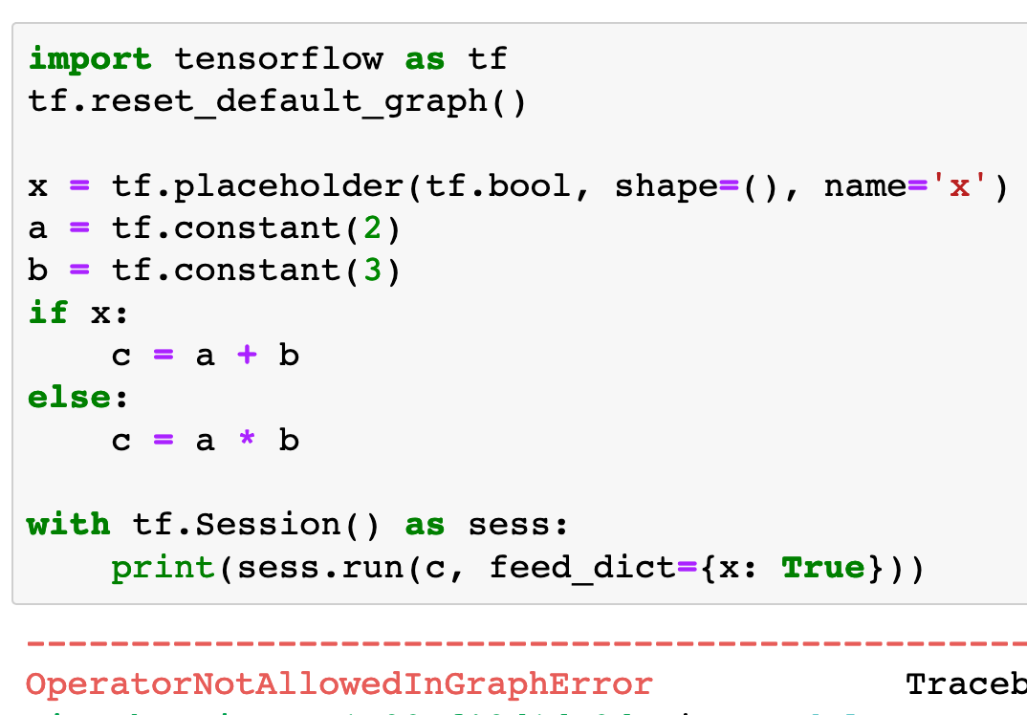

Slide 8
if x is not None: - Fail

Slide 9
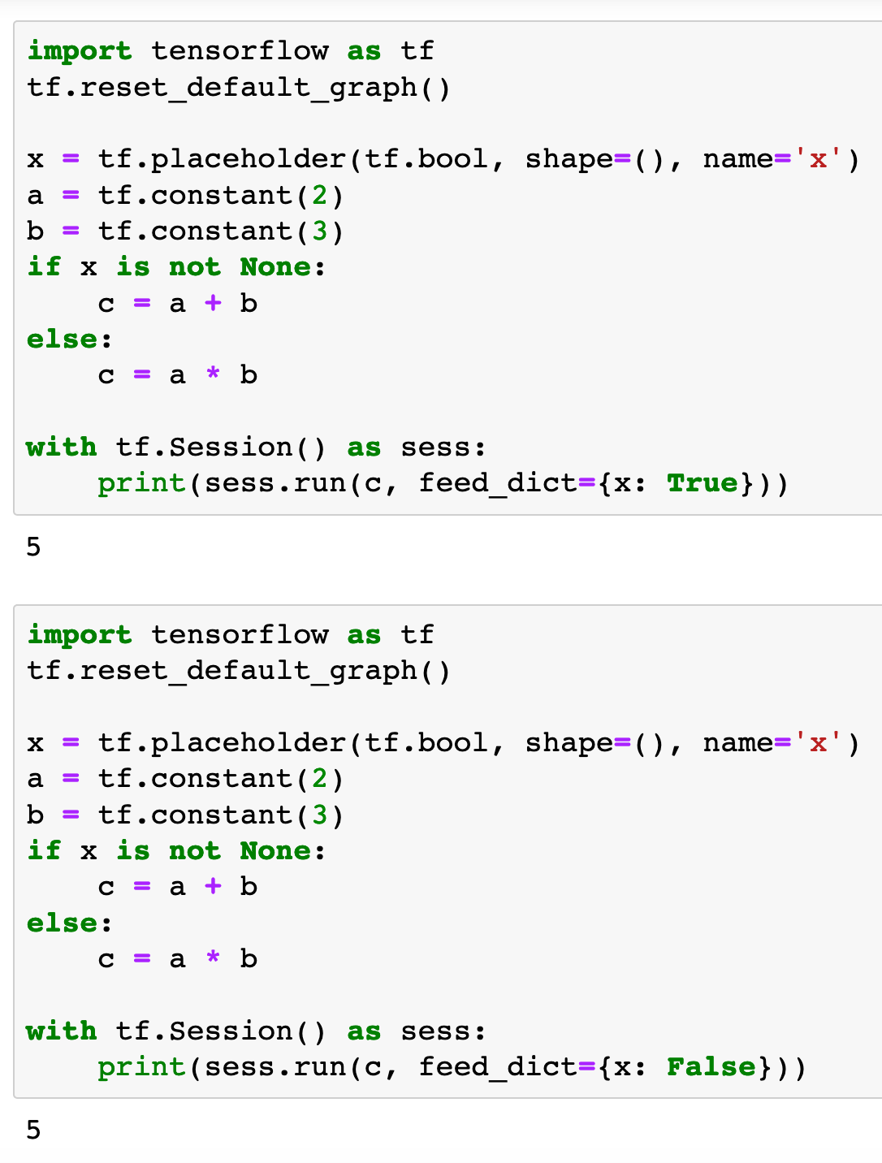

Slide 11
tf.cond - Failed Attempt

Slide 12
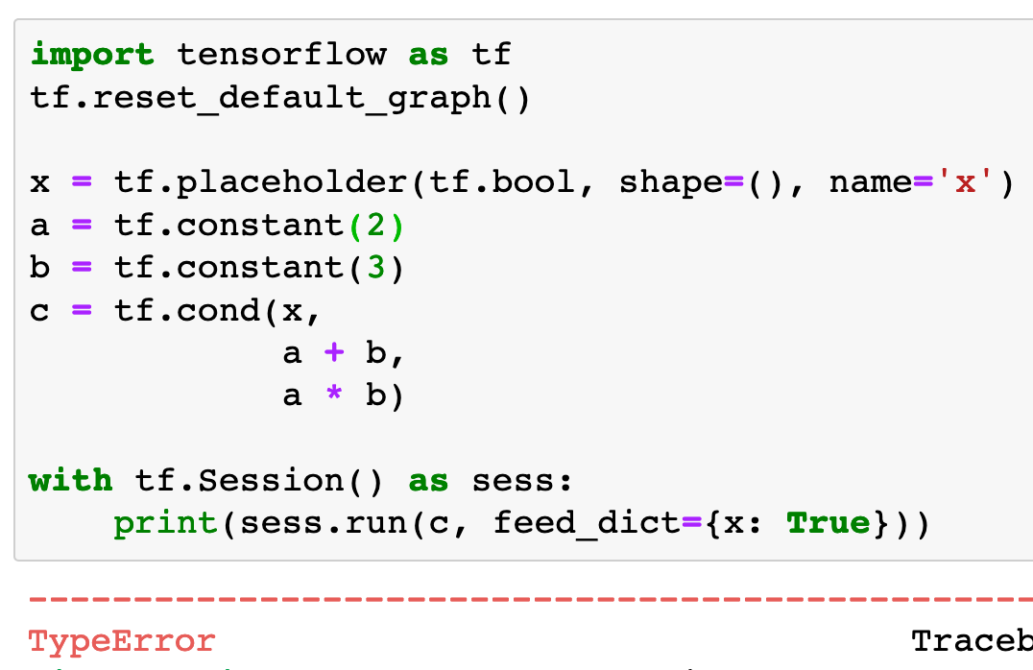

Slide 13
tf.cond - Success

Slide 14
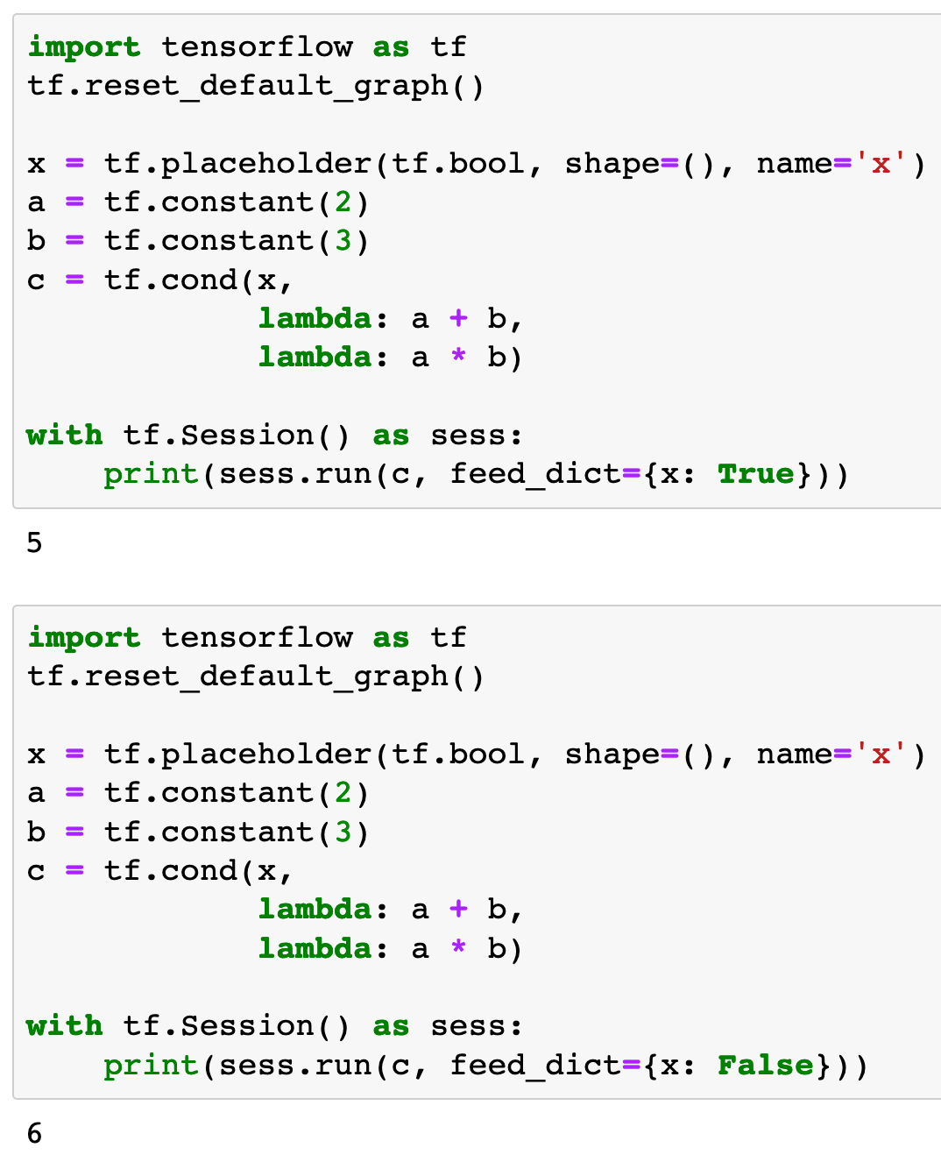

Slide 16
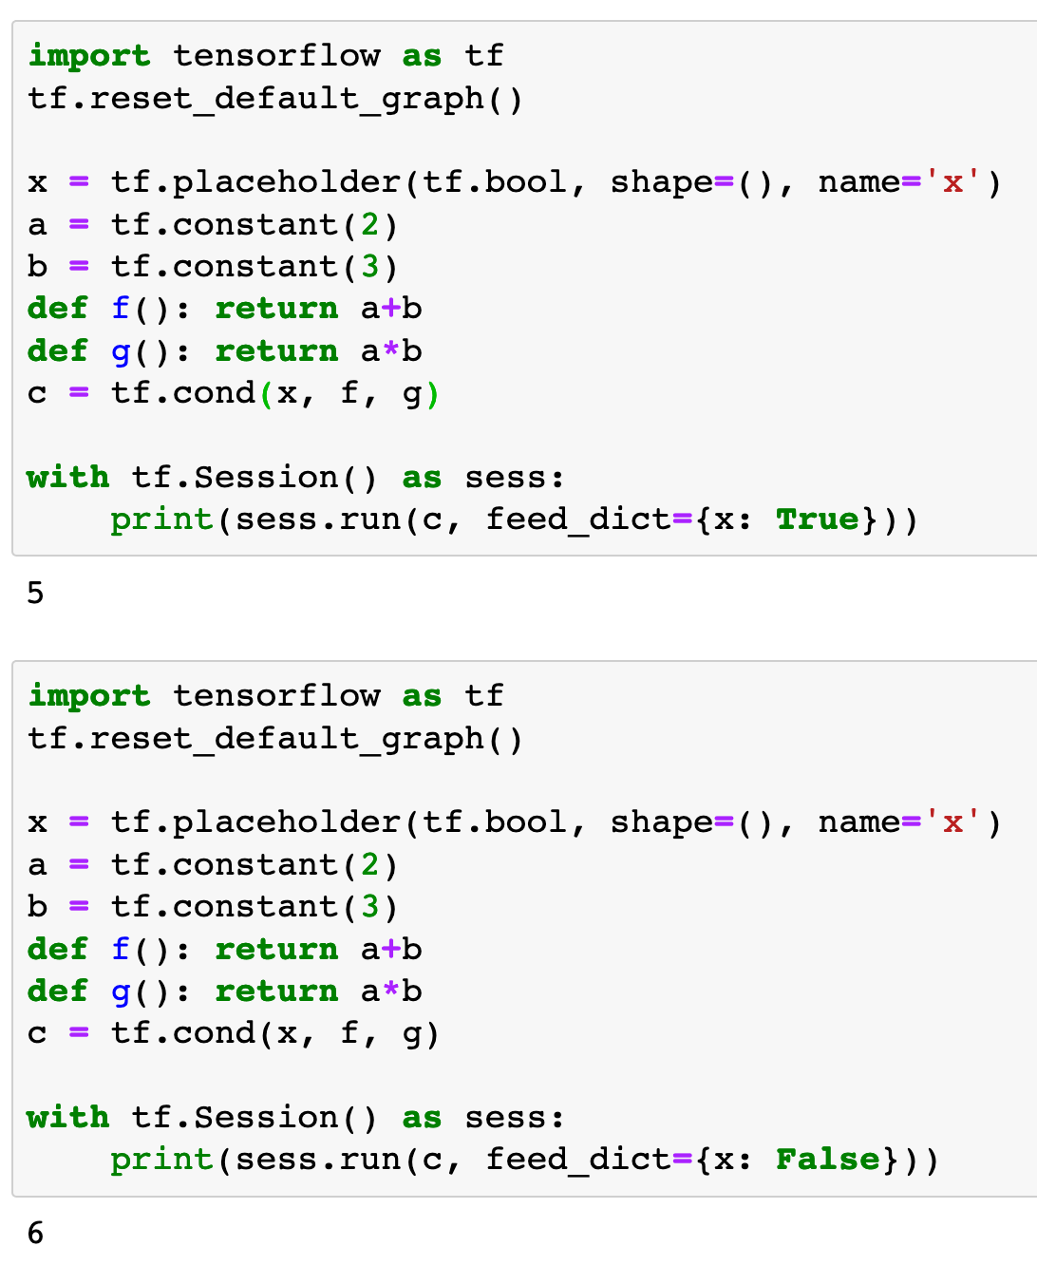

Slide 18
tf.cond - Comparison

Slide 19
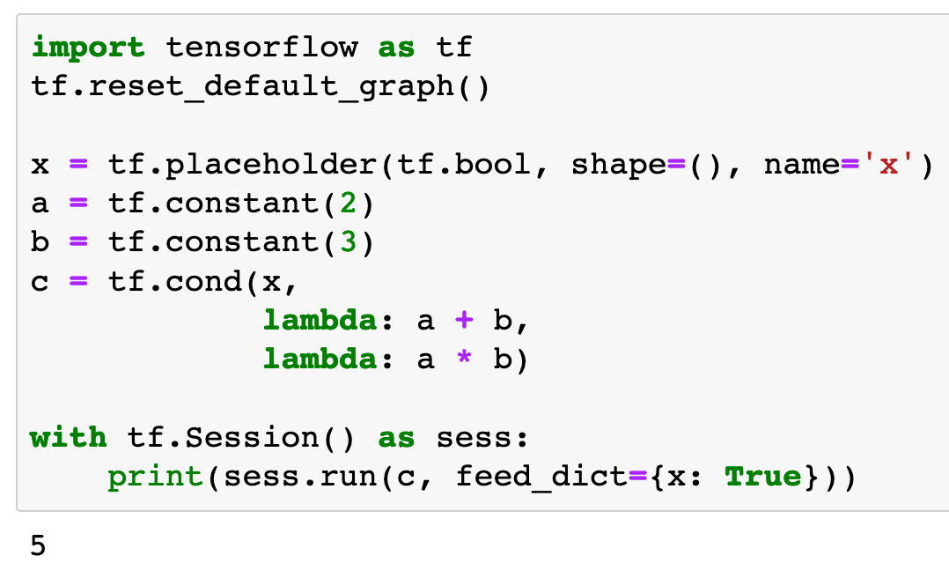
Fail
Success

Slide 20
Fail
Success

Slide 21
Fail
Not Callable
Success

Slide 22
Fail
Not Callable
Success
Callable

Slide 23
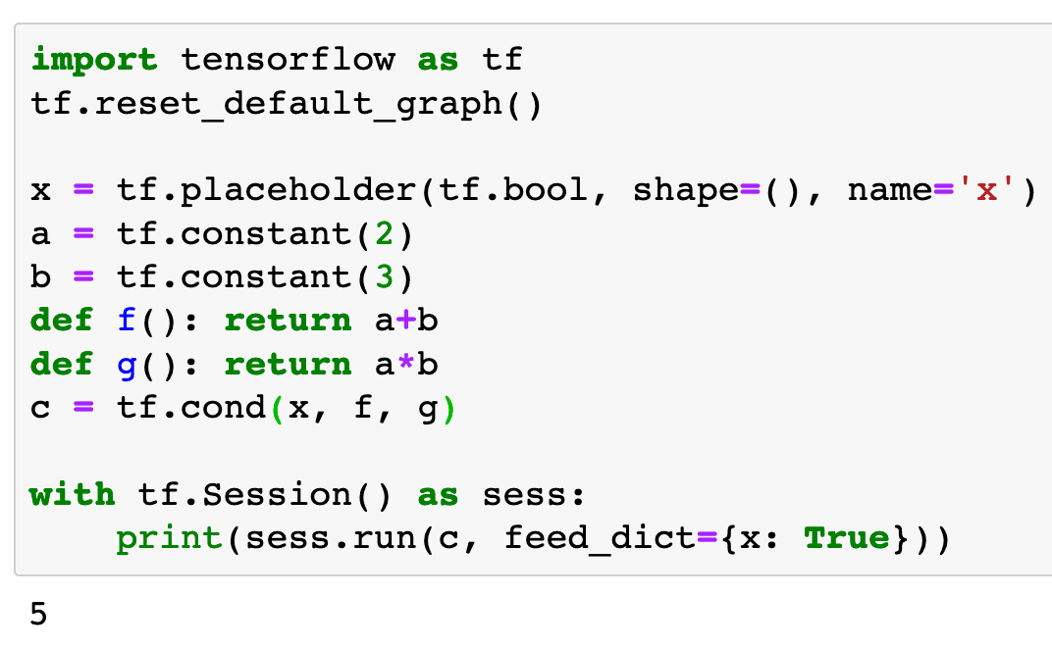
Fail
Success

Slide 24
Fail
Success

Slide 25
Fail
Not Callable
Success

Slide 26
Fail
Not Callable
Success
Callable

Slide 27
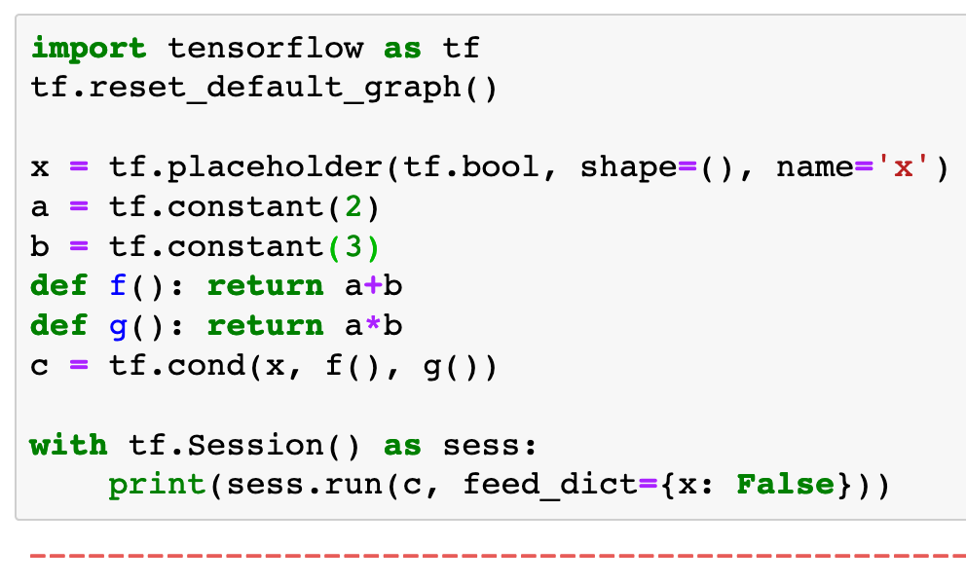

Fail
Success

Slide 28
Fail
Success

Slide 29
Fail
Not Callable
Success

Slide 30
Fail
Not Callable
Success
Callable

Slide 31
Now
Let’s Play with Code

